Slide 1
Martin Luther King Jr.’s “I Have a Dream” speech
Joshua Austin
May 19, 2015

Slide 2
People
Martin Luther king Jr. was the last speaker.
John Lewis was the chairman of SNCC.
Phillip Randolph 74 year labor leader speaker.

Slide 3
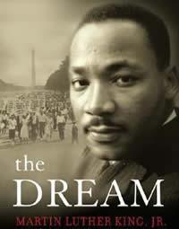
People – Martin Luther king Jr.
His statue is the only statue the is not an war memorial or president.
Martin Luther King article

Slide 4
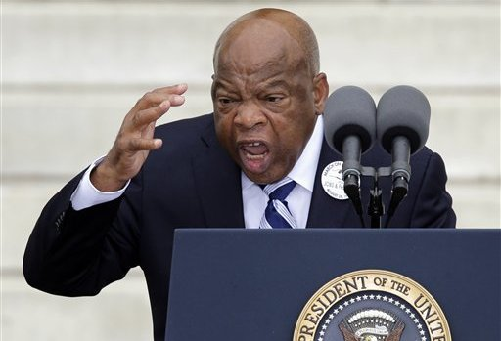
People - John Lewis
John Lewis is still alive and is a Georgia congressman
John Lewis at 50th anniversary of March on Washington

Slide 5
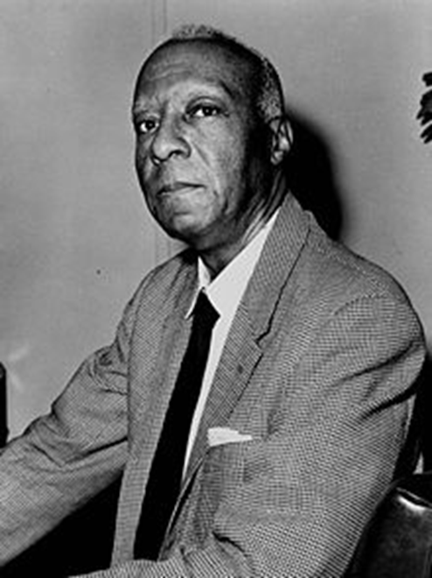
People – Phillip Randolph
Phillip Randolph led the March on Washington.
Article on Phillip Randolph

Slide 6
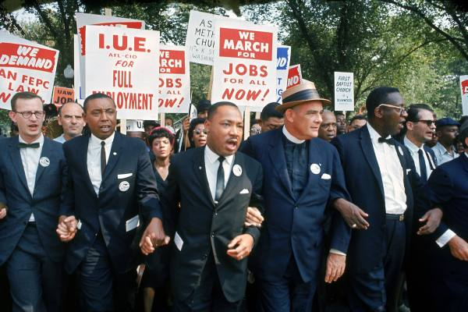
Date
August 28, 1963
People said their speeches

Slide 7
Time line
1963 they planned the March on Washington but it did not happen.
March 1964
Pools integrate.
Students protest.

Slide 8
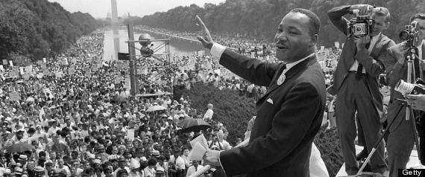
Location
Washington D.C. at the Lincoln memorial
Speeches for the March on Washington

Slide 9
Important Details
There were several speakers.
Martin Luther king Jr. was the last speaker.
King put away his prepared notes and did his dream speech.
Each speaker only had 15 minutes to speak.

Slide 10
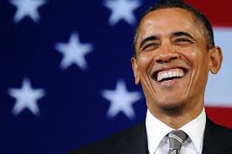
Outcomes
It changed how white people think about black people.
It made racism illegal.
We have a black person as our President of the United States of America. His name is Barack Obama.
article on Obama makes history by being the first black president

